Slide 1
HTTPS and Secure Communication Uploading Files

Slide 2
Objectives
Understand about secure communication between the client and server using the HTTPS protocol
Set up the server to use HTTPS and configure the certificate and private key for use with HTTPS
Configure the Multer module to enable file uploading
Set up your Express server to use Multer to upload files to a designated folder

Slide 3
HTTPS and Secure Communication

Slide 4
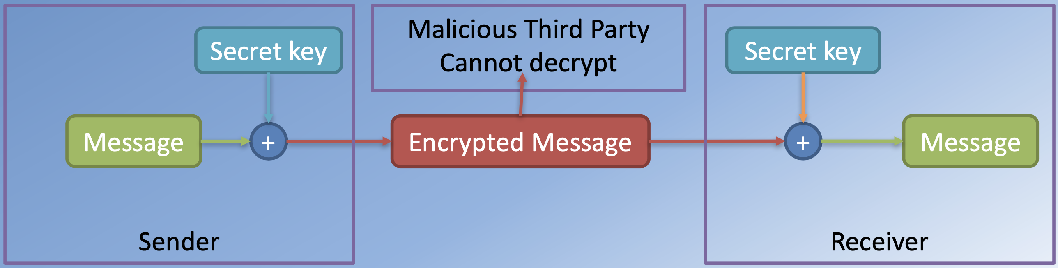
Symmetric Key Cryptography
Symmetric Encryption:
Shared secret key between the two parties

Slide 5
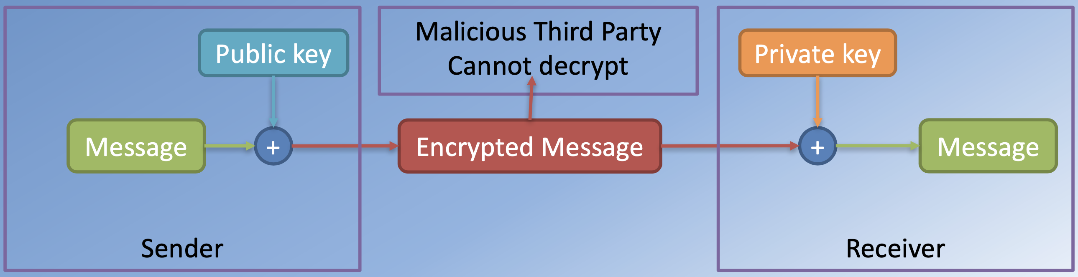
Public Key Cryptography
Asymmetric Encryption:
Public key that can be widely distributed
Private key that is only known to the receiver

Slide 6
Secure Sockets Layer (SSL) / Transport Layer Security (TLS)
Cryptographic protocols that enable secure communication over an insecure network like the Internet
Privacy and Integrity of the communication protected
Uses a combination of public-key crytography and symmetric cryptography

Slide 7
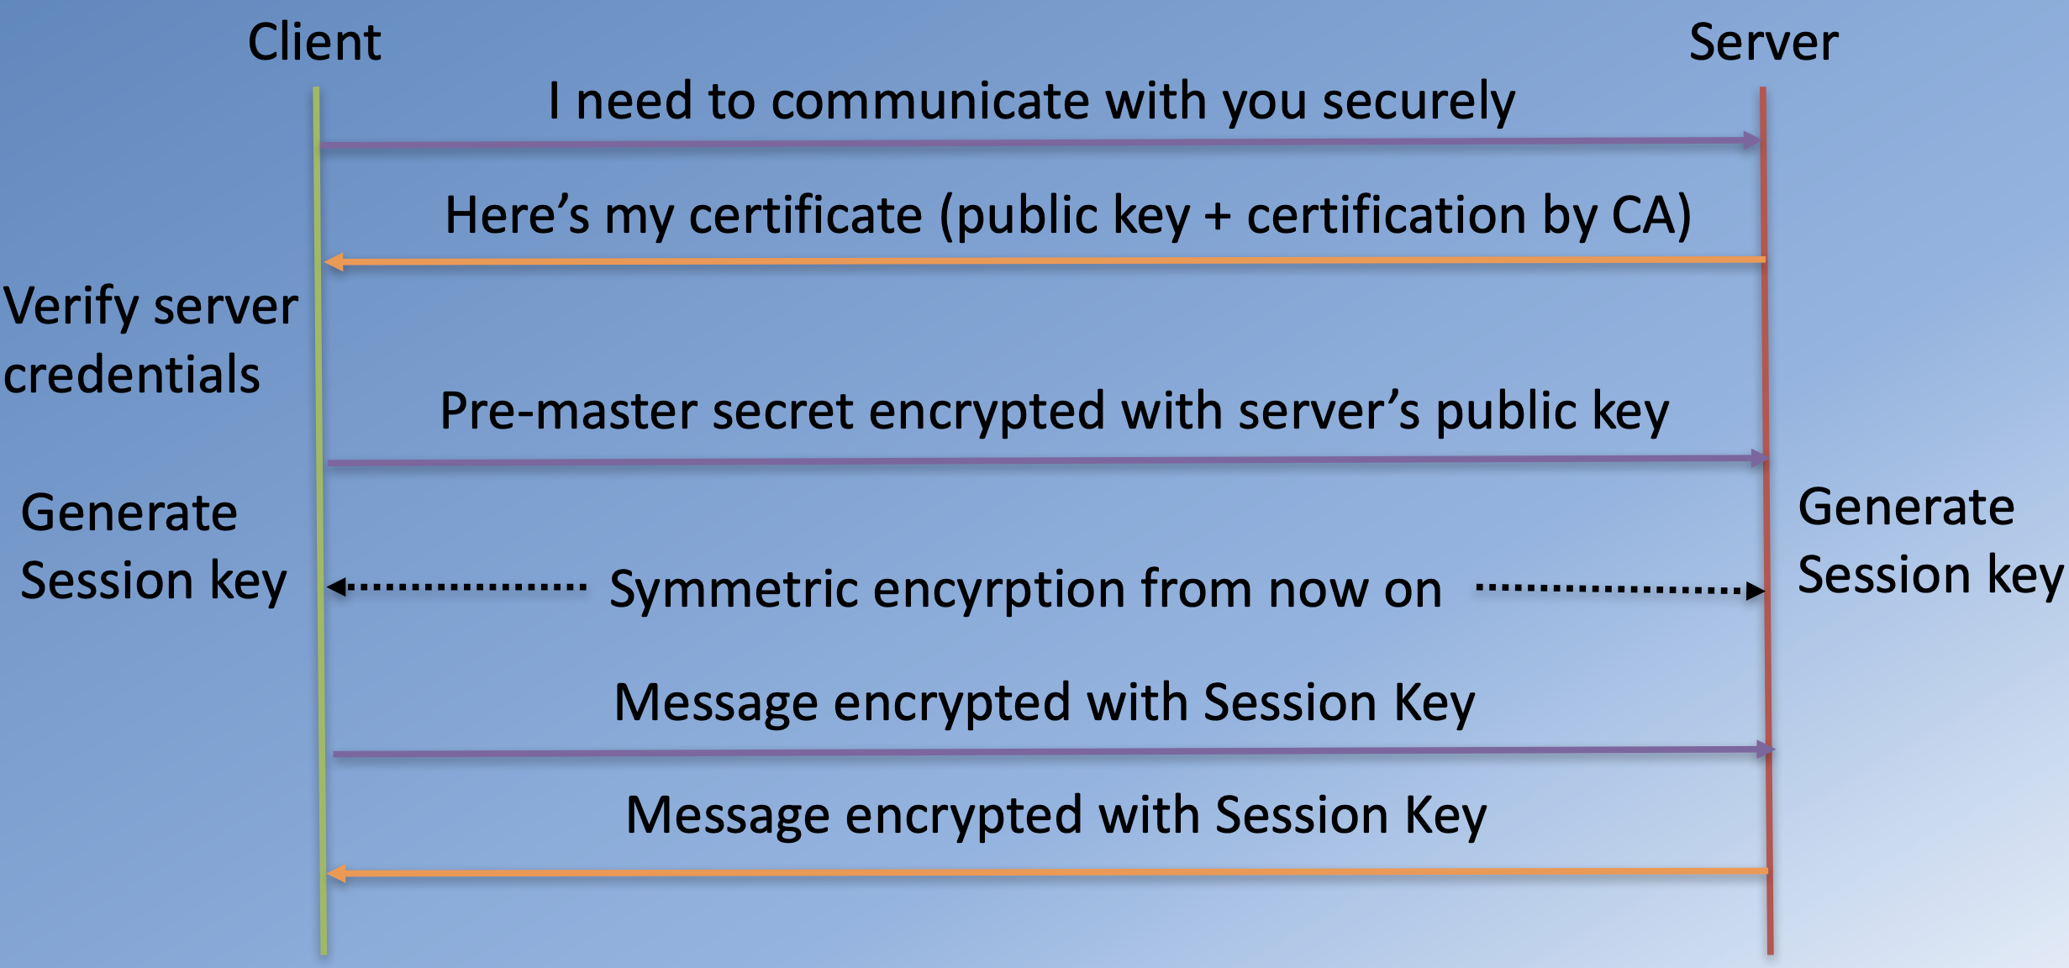
SSL/TLS Handshake

Slide 8
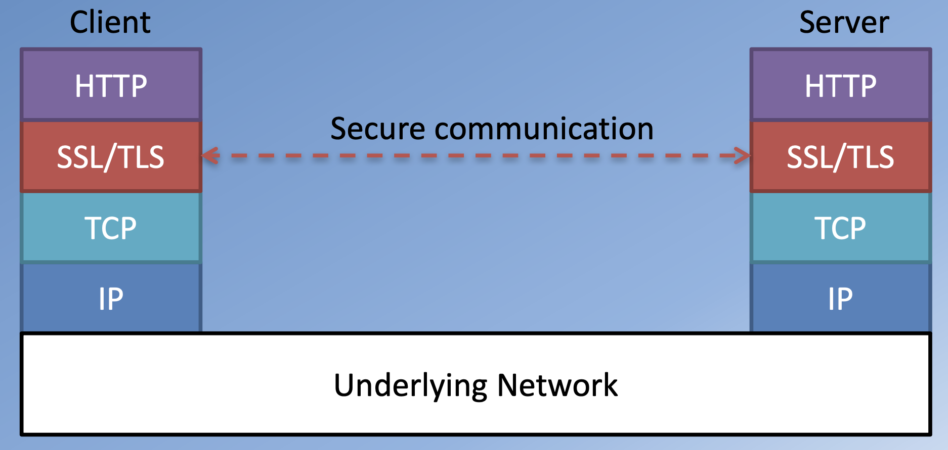
HTTPS

Slide 9
Generating Keys
Use openssl for generating keys for testing openssl genrsa 1024 > private.key openssl req -new -key private.key -out cert.csr openssl x509 -req -in cert.csr -signkey private.key -out certificate.pem
For production environment / deploying to a production server you need to get the keys and certificate from a certification authority (CA) e.g., Verisign, Thawte

Slide 10
Node HTTPS Module
HTTPS core module in Node:
var https = require('https'); var fs = require('fs');
var options = { key: fs.readFileSync(__dirname+'/private.key'), cert: fs.readFileSync(__dirname+'/certificate.pem')
}; var secureServer = https.createServer(options,app);

Slide 11
Exercise - HTTPS and Secure Communication

Slide 12
Uploading Files

Slide 13
File Upload
File uploading is typically supported through form input
<input type=“file” name=“imageFile”>
Form data typically encoded as:
application/x-www-form-urlencoded
multipart/form-data
Applied to Form element’s enctype attribute
<form action=“/imageUpload” method=“post” enctype=“multipart/form-data”>
File upload is more efficient with multipart/form-data
HTML5 (W3C Recommendation), IETF RFC 1867, 7578

Slide 14
File Upload
The multipart/form-data when included will have a request header as:
‘content-type’: ‘multipart/form-data; boundary=---- 703214596543452114973547’
Boundary separates the multipart request body

Slide 15
Multer
Node middleware for handling multipart/form-data
Written on top of busboy, a Node module for parsing incoming HTML form data
Parses the incoming form data and adds a body object and file/files object to request object

Slide 16
Exercise - Uploading Files

Slide 17
Summary
Configure a secure server in Node using the core HTTPS module
Generate the private key and public certificate and configure the HTTPS server
Redirect traffic from the insecure HTTP server to a secure HTTPS server.
Configure the Multer module to enable file uploads
Use the Multer module in your Express application to enable file uploads to a designated folder

